Slide 1
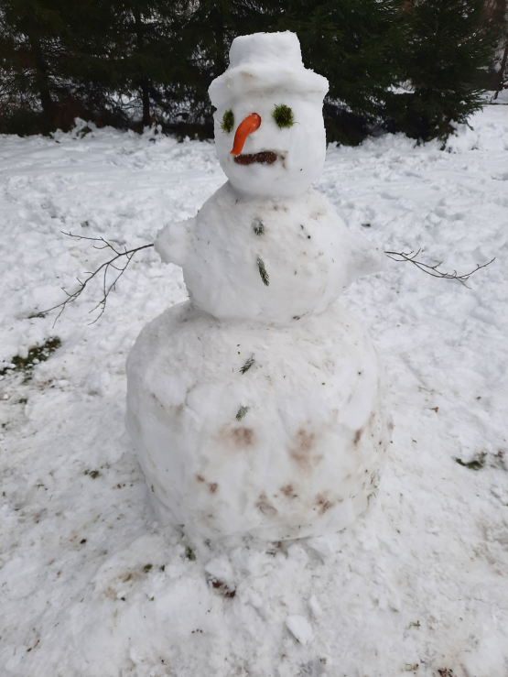
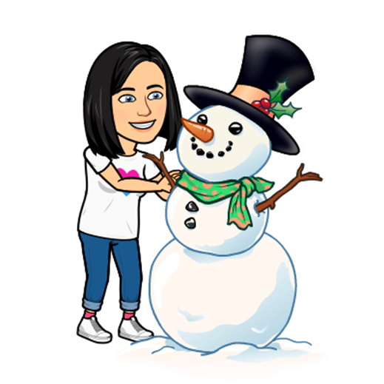

„BUILD“ YOUR SNOWMAN
- dice games

Slide 2
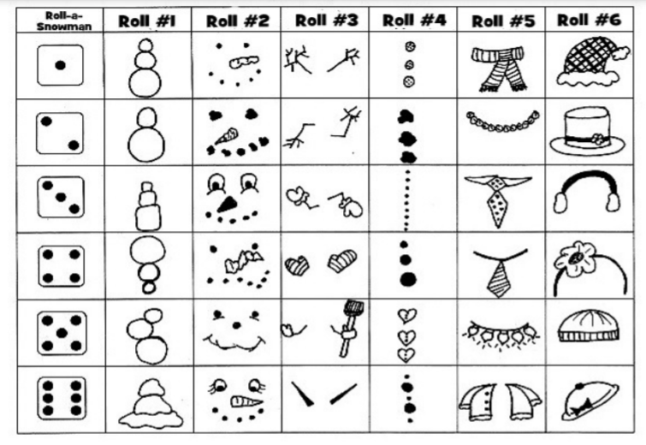
ROLL A SNOWMAN

