Slide 1


DANES IMAM ZA VAS PRIPRAVLJENO ZIMSKO UGANKO.
NATANČNO SI OGLEJTE FOTOGRAFIJE,
UGANITE KAJ JE NA SLIKAH IN UGANITE, ZAKAJ SEM POTREBOVALA VSE TE STVARI.
LET´S GO!

Slide 2
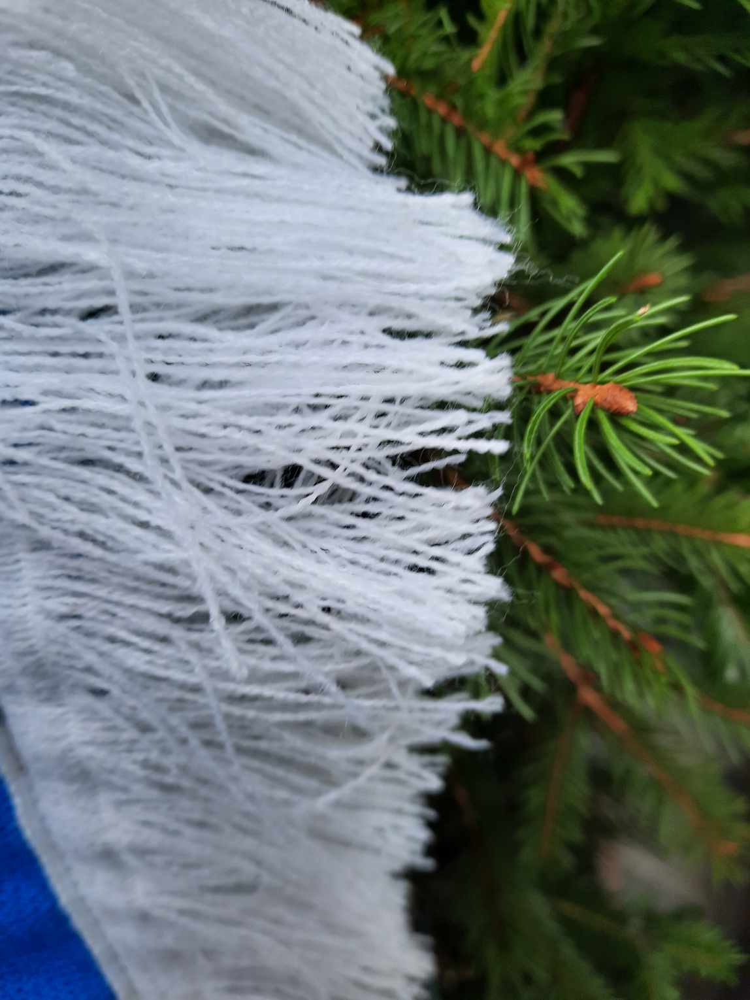
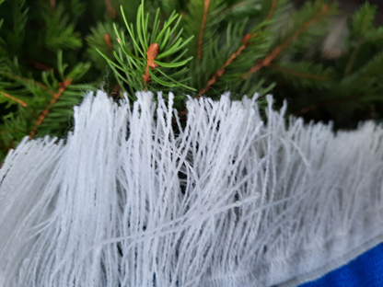

WHAT IS THIS?

Slide 3
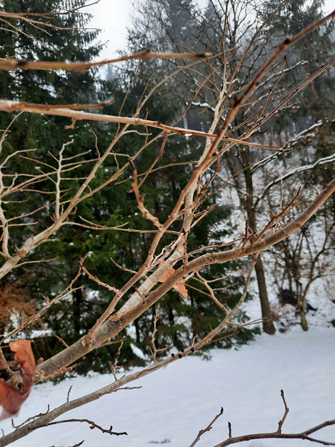
WHAT IS THIS?

Slide 4
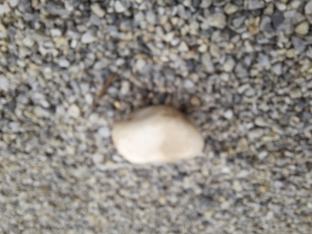

WHAT IS THIS?

Slide 5
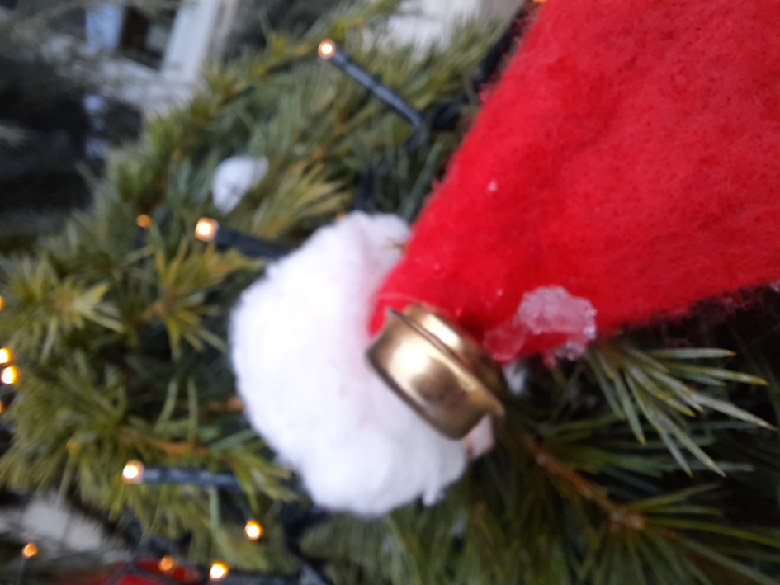


Slide 6

WHAT IS THIS?

Slide 7
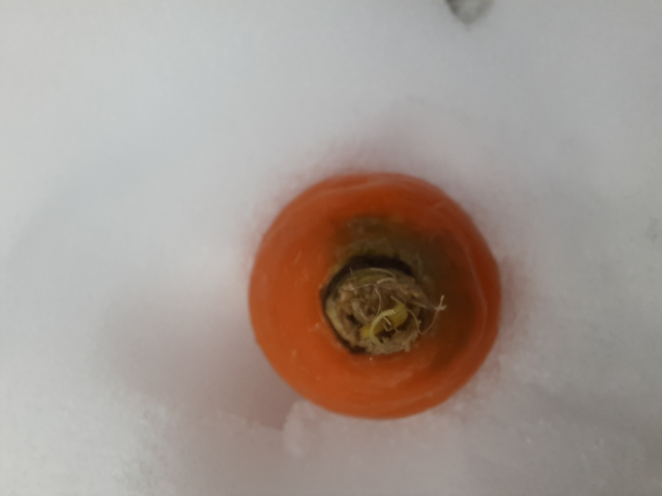

Slide 8

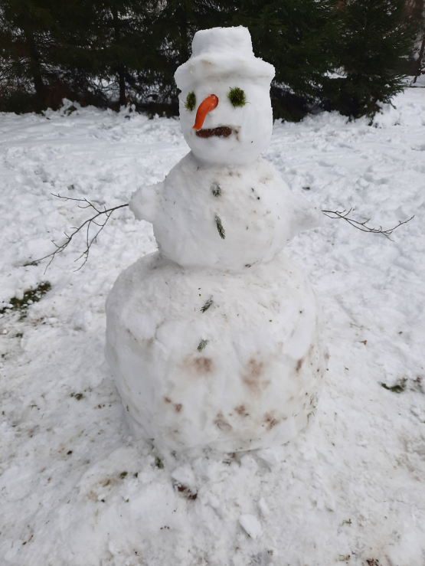
YOU´RE RIGHT!
I DID A SNOWMAN.
THIS IS MY SNOWMAN.

