Slide 1










DO
?
AT
.

Slide 2


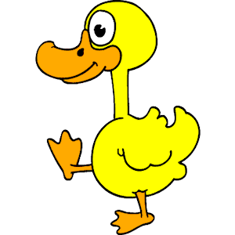
DO
?
AT
.

Slide 3


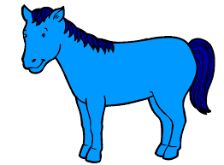
DO
?
AT
.

Slide 4




DO
?
AT
.

Slide 5


DO
?
AT
.

Slide 6

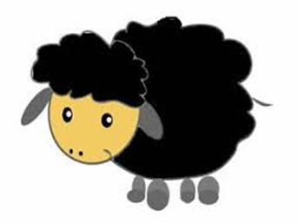
DO
?
AT
.

Slide 7


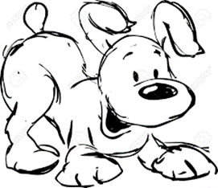
DO
?
AT
.

Slide 8




DO
?
AT
.

Slide 9
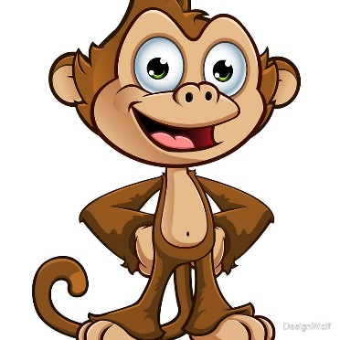
DO
?
AT
.
.

Slide 10

DO
?
AT
.

Slide 11

DO
?

Slide 12

AT US.

