Slide 1
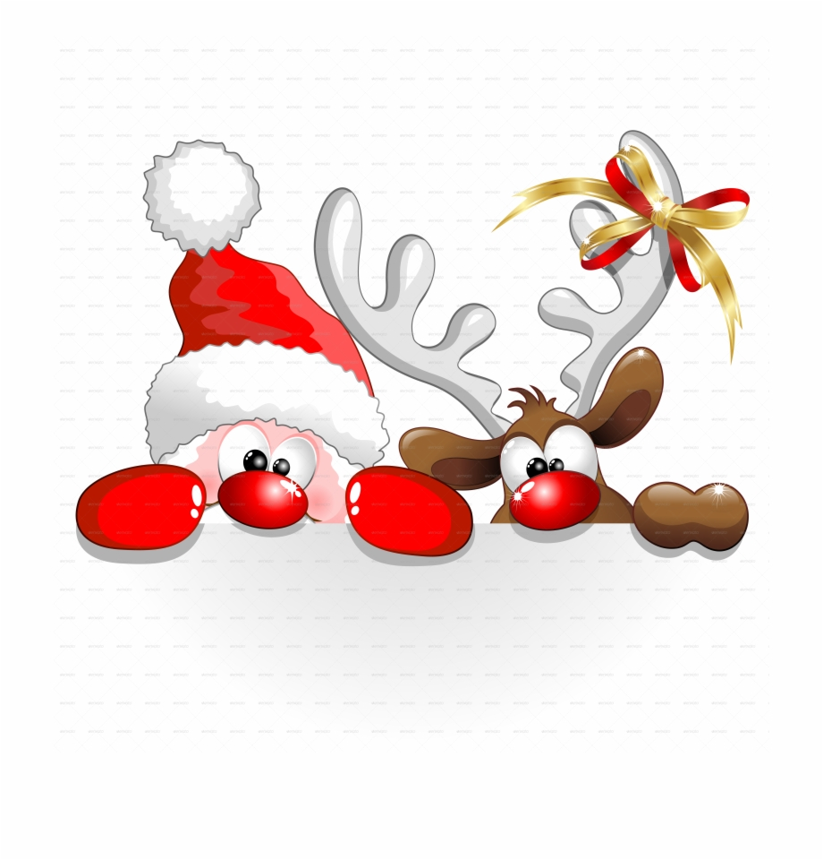
CHRISTMAS JOKES

Slide 2
What are the names of December’s three older brothers?
What is red and white, red and white, red and white?
A cember, B cember, and C cember.
Santa Claus rolling down a hill.

Slide 3
How do you call a snowman in the summer?
What do monkeys sing at Christmas?
Jungle bells, jungle bells!
Water!

Slide 4
Why is it always cold at Christmas?
What do elves learn at school?
Because it´s Decemberrrrrrrrrr.
The ELF-abet!

Slide 5
What does a snowman eat for breakfast?
Why is Senta so good at karate?
Because he has a black belt.
Snowflakes!

